Slide 1
Systems Analysis and Design
Chapter 1
Introduction to Systems Analysis and Design

Slide 2
Chapter Objectives
Describe the impact of information technology
Define systems analysis and design and the role of a systems analyst
Define an information system and describe its components
Explain how to use business profiles and models
Explain Internet business strategies and relationships, including B2C and B2B

Slide 3
Chapter Objectives (Cont.)
Identify various types of information systems and explain who uses them
Distinguish among structured analysis, object-oriented analysis, and agile methods
Explain the waterfall model, and how it has evolved
Discuss the role of the information technology department and the systems analysts who work there

Slide 4
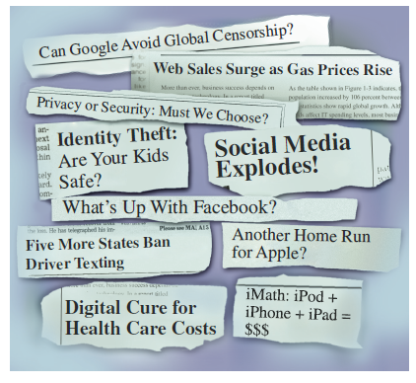
Introduction
Companies use information as a weapon in the battle
to increase productivity,
deliver quality products and services,
maintain customer loyalty, and
make sound decisions
Information technology can mean the difference between success and failure
FIGURE 1-1 These headlines show the enormous impact of information technology on our lives.
Notes:
Companies live and die by information

Slide 5
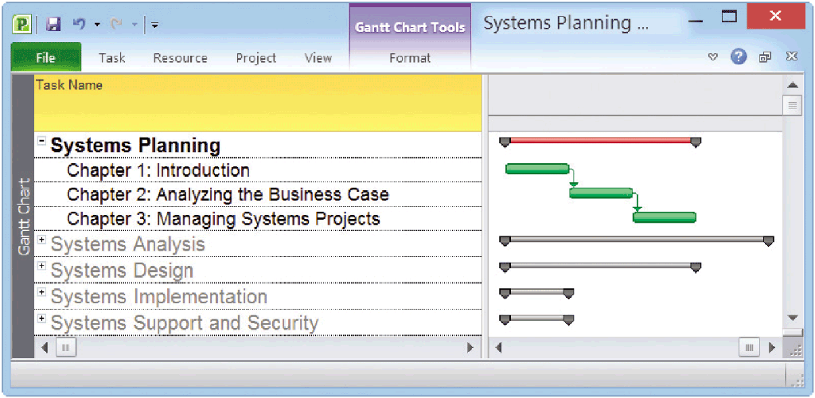
Systems Development Life Cycle - SDLC
Notes:
SDLC – some include a 6th maintenance

Slide 6
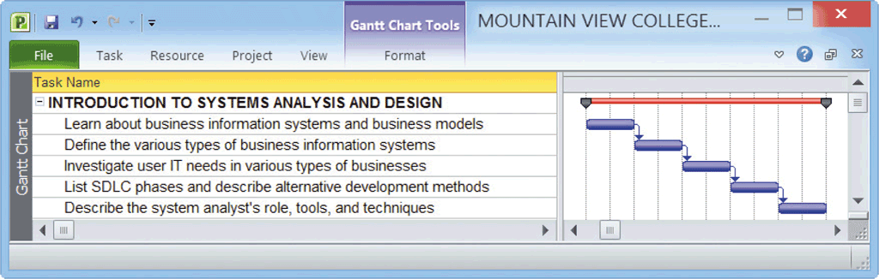
Typical Introductory Tasks for System Projects

Slide 7


What Is Information Technology?
Information Technology (IT)
Combination of hardware and software products and services that companies use to manage, access, communicate, and share information
Welcome to the 21st Century: The IT Journey Continues
Changes in the world
Changes in technology
Changes in client demand
FIGURE 1-3 How times have changed!

Slide 8
What Is Information Technology? (Cont.)
Systems Analysis and Design
Step-by-step process for developing high-quality information systems
What Does a Systems Analyst Do?
Plan, develop, and maintain information systems
Also manages IT projects, including tasks, resources, schedules, and costs
Conducts meetings, delivers presentations, and writes memos, reports, and documentation
Notes:
The systems can handle routine day to day tasks, others help managers make better decisions, spot marketplace trends, reveal patterns in data.
Information systems are designed by a mix of managers, users, network administrators, Web designers, programmers and systems Analysts.
Systems Analysts are often assigned to the IT dept but they can be assigned to any department.

Slide 9
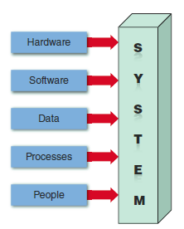
Information System Components
A system is a set of related components that produces specific results
Mission-critical systems are vital to a company’s operations
Information systems have five key components: hardware, software, data, processes, and people
FIGURE 1-6 An information
system needs these components.
Notes:
All 5 components are necessary

Slide 10
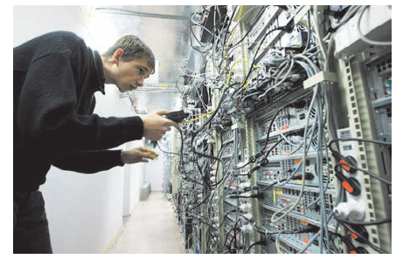
Information System Components (Cont.)
Hardware
Is the physical layer of the information system
Moore’s Law
Software
System software
Application software
Horizontal system
Vertical system
Legacy systems
FIGURE 1-7 Server farms provide the enormous power and speed that modern IT systems need.
Notes:
In 1965 Gordon Moore the co-founder of Fairchild Semiconductor and Intel stated - the number of transistors on an integrated circuit chip would double about every 24 months. This has remained valid for almost 50 years. It was called Moore’s Law after him. Moore’s Law is an observation not an actual law. The rate held study from 1975 until 2012 when Moore noticed a slowing. In 2015 the pace of advancement slowed as stated by Intel. The pace now is about 2 and ½ years.

Slide 11
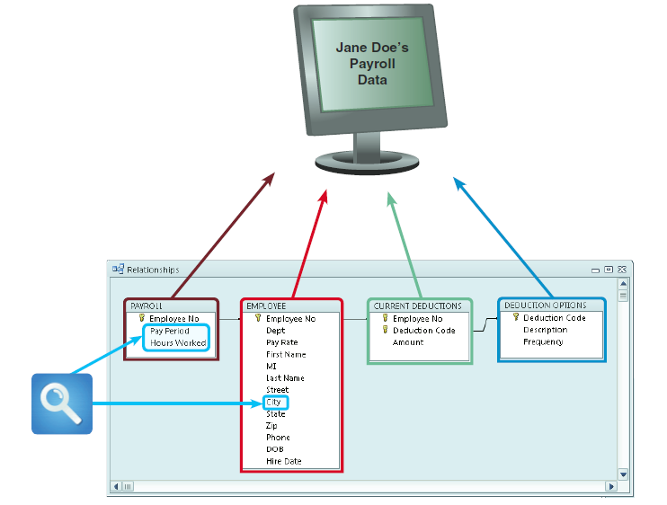
Information System Components (Cont.)
Data
Tables store data
Linked tables work together to supply data
Processes
Describe the tasks and business functions that users, managers, and IT staff members perform to achieve specific results
People
Stakeholders
Users or end users
FIGURE 1-8 In a typical payroll system, data is stored in separate tables that are linked to form an overall database.
Notes:
Data is raw material, such as the hours people work in a payroll system.

Slide 12
Business in the 21st Century
Three major trends:
Rapidly increasing globalization
Technology integration for seamless information access
Rapid growth of cloud-based computing and services
All trends are Internet-centric and driven by the immense power of the Web
Notes:
To design a successful project, the designers must understand how the business works – it’s day to day operations, all the way up to the boss. Every business is different, a small retail shop, a veterinarian, and a hotel chain all have different requirements. Business will be shaped by the 3 major trends above.

Slide 13
Business in the 21st Century (Cont.) The Internet Model
E-commerce or I-commerce Two main sectors:
B2C (Business-to-Consumer)
B2B (Business-to-Business)
EDI
Supply chain management (SCM)
Supplier relationship management (SRM)
What’s Next?
Traditionally, IT companies were product-oriented or service-oriented
Today’s IT companies offer a mix of products, services, and support
Notes:
Internet based commerce: e-commerce or I-commerce (Internet commerce) . Internet based business involves various hardware and software designs, but a typical model is a series of Web pages that provide a user-interface, which communicates with database management software and a Web-based data server.

Slide 14
Business in the 21st Century (Cont.)
Internet-dependent firms
Primary business depends on the Internet rather than a traditional business channel
Brick-and-mortar firms
Have physical stores where customers can see and touch the products
Have expanded their Web-based marketing channels to increase sales and serve customers better
Combine convenience of online shopping and the alternative of hands-on purchasing
Lowe’s, Costco, Target, and Wal-Mart are examples

Slide 15
Business in the 21st Century (Cont.)
The Web-based business model leveled the playing field for small firms that now can reach a global marketplace
Discount coupon business gets a new life
eBay and Groupon
Firms now using global positioning system (GPS) coordinates to tempt buyers with nearby deals

Slide 16
Business in the 21st Century (Cont.)
Business Profiles
Overview of a company’s mission, functions, organization, products, services, customers, suppliers, competitors, constraints, and future direction
Business Processes
Specific set of transactions, events, and results that can be described and documented
A business process model (BPM ) graphically displays one or more business processes next slide shows a simple model that includes an even, three processes and a result.
Notes:
Systems analysts use modeling to represent company operations and information systems. Part B of the Toolkit at the back of the book.

Slide 17
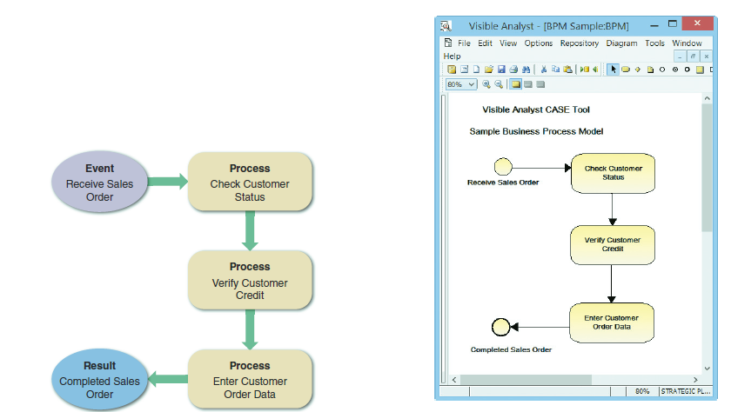
Business in the 21st Century (Cont.)
FIGURE 1-14 A simple business model might consist of an event, three processes, and a result.
FIGURE 1-15 This sample uses business process modeling notation (BPMN) to represent the same events,
processes, and workflow shown in Figure 1-14.
Notes:
Understand the Business - developers must understand a businesses operations to be able to design a successful system
Business Process Model (BPM) – graphically displays one or more business processes, such as handling an airline reservation, processing a customer order
Business process – a specific set of transactions, events, and results that can be described and documented.
In some cases a sketch will work, in other situations there are computer-tools (Visible Analyst is the one shown on the left) that use standard shapers and symbols to represent events, process, workflows, etc.

Slide 18
Business in the 21st Century (Cont.)
Business Information Systems
The old way:
Administrative staff used office systems
Operational people used operational systems
Middle managers used decision support systems
Top managers used executive information systems
The “now” way
All employees use office productivity systems
Operations users require decision support systems
Notes:
Companies are blending skills
In the past systems were identified based on their primary users. Now all employees use a wide variety of systems to complete their jobs.

Slide 19
Business in the 21st Century (Cont.)
A new set of system definitions
Enterprise computing systems
Transaction processing systems
Business support systems
Knowledge management systems
User productivity systems
Notes:
Business Information Systems

Slide 20
Business in the 21st Century (Cont.)
Enterprise Computing
Information systems that support company-wide operations and data management requirements
Examples:
Wal-Mart’s inventory control system
Boeing’s production control system
Hilton Hotels’ reservation system
Applications called enterprise resource planning (ERP) systems provide cost-effective support for users and managers throughout the company
Notes:
Used company wide. For Example a car rental company can use ERP to forecast customer demand for rental cars at hundreds of locations.

Slide 21
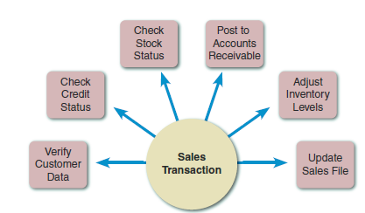
Business in the 21st Century (Cont.)
Transaction Processing
Transaction processing (TP) systems process data generated by day-to-day business operations Examples:
Customer order processing
Accounts receivable
Warranty claim processing
A TP system verifies customer data, checks customer credit, checks stock status, posts to accounts receivable, adjusts inventory levels, and updates the sales file
FIGURE 1-17 A single sales transaction consists of six separate tasks, which the TP system processes as a group.
Notes:
When a specific transaction occurs, these are the 6 steps that will be executed. TP systems generally involve large amounts of data and are mission-critical. The business can’t function without them.

Slide 22

Business in the 21st Century (Cont.)
Business Support
Provide job-related information support to users at all levels of a company
Can work hand-in-hand with a TP system
A New development in data acquisition
is RFID
Radio frequency identification (RFID) technology uses high-frequency radio waves to track physical objects.
FIGURE 1-18 With an RFID tag, items can be tracked and monitored throughout the shipping process.
Notes:
Business Support Systems give job-related information support to users at all levels. In the old days only managers got the needed information, now employees at all levels need information to get their jobs done.

Slide 23
Business in the 21st Century (Cont.)
Knowledge Management
Uses a large database called a knowledge base
Allows users to find information by entering keywords
Uses inference rules, which are logical rules that identify data patterns and relationships
Notes:
Also called expert systems because they contain a knowledge base and inference rules that determine how the knowledge is applied. An example would be using the Dell computer site support area to find a solution to a problem

Slide 24
Business in the 21st Century (Cont.)
User Productivity
Technology that improves productivity
Groupware
Systems Integration
Most large companies require systems that combine transaction processing, business support, knowledge management, and user productivity features
Notes:
User Productivity systems – email, voice mail, fax, video and Web conferencing, word processing, spreadsheets, databases, presentation software, automated calendars, desktop publishing, company intranets. For instance, a customer service rep could enter a complaint into the system that would then update two other systems. A knowledge management system that tracks problems and warranty claims and a quality control system which uses the info to determine if changes need to be made to the product.

Slide 25
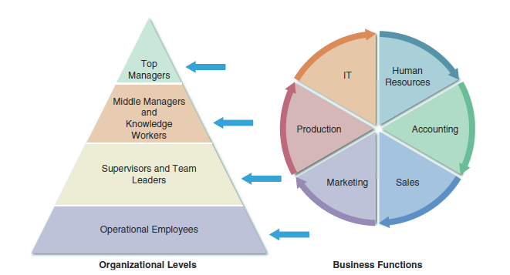
What Information Do Users Need?
FIGURE 1-20 A typical organizational model identifies business functions and organizational levels.
Notes:
A system analyst must understand the company’s organizational model to recognize who is responsible for specific processes and decisions and to be aware of what information is required by whom.

Slide 26
What Information Do Users Need? (Cont.)
Top Managers
Develop long-range strategic plans, which define the company’s overall mission and goals
Need information on economic forecasts, technology trends, competitive threats, and governmental issue
Middle Managers and Knowledge Workers
Provide direction, necessary resources, and performance feedback to supervisors and team leaders
Need more detailed information than top managers
Notes:
Top Managers – ask how much should the company invest in _______________?, or How much will Internet sales grow in the next 5 years? They are looking 3,5,10 years down the road.
Middle Managers – might review weekly sales for a 3 state area

Slide 27
What Information Do Users Need? (Cont.)
Supervisors and Team Leaders
Oversee operational employees and carry out day-to-day functions
Need decision support information, knowledge management systems, and user productivity systems
Operational Employees
Rely on TP systems to enter and receive data they need to perform their jobs
Need information to handle tasks and make decisions previously made by supervisors
Notes:
Supervisors – oversee operational employees and see to day to day operations
Operational Employees -

Slide 28
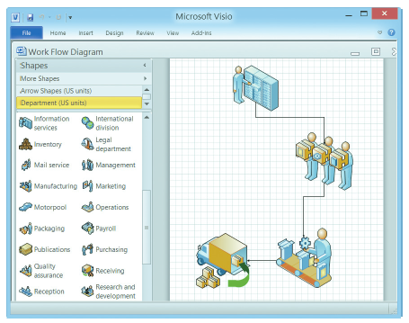
Systems Development Tools
Modeling
Business model
Requirements model
Data model
Object model
Network model
Process model
FIGURE 1-21 Microsoft Visio allows you to drag and drop various symbols and connect them to show a business process.
Notes:
Used several types of tools to plan, design and implement information systems. Modeling produces a graphical representation of a concept or process.
Business model – describes the information that a system must provide.
Requirements model – show what elements are absolutely required
Data model – show how data moves through a company
Object model – combine data and processes
Network model –
Process model – how processes move through a company

Slide 29
Systems Development Tools (Cont.)
Prototyping
Early working version of an information system
Speeds up the development process significantly
Important decisions might be made too early, before business or IT issues are thoroughly understood
A prototype based on careful fact-finding and modeling techniques can be an extremely valuable tool

Slide 30
Systems Development Tools (Cont.)
Computer-Aided Systems Engineering (CASE) Tools
Provide an overall framework for systems development and support a wide variety of design methodologies such as:
Structured analysis
Object-oriented analysis
Can generate program code, which speeds the implementation process

Slide 31
Systems Development Methods
Structured Analysis
Traditional method for developing systems
Organized into phases
Object-Oriented Analysis
More recent method for developing systems
Objects represent actual people, things, or events
Agile/Adaptive Methods
Latest trend in software development
Team-based effort broken down into cycles

Slide 32
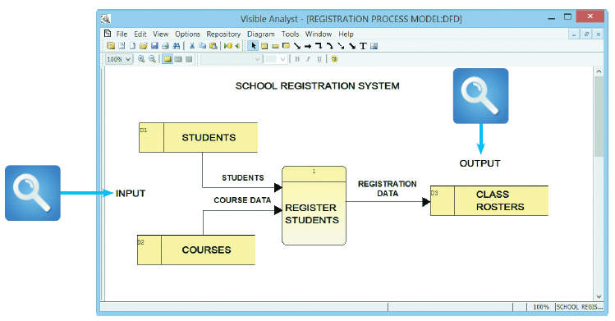
Systems Development Methods (Cont.)
Structured Analysis
Time-tested and easy to understand
Uses phases called the systems development life cycle (SDLC)
Predictive approach
Uses process models to describe a system graphically
FIGURE 1-24 This Visible Analyst screen shows a process model for a school registration system. The REGISTER STUDENTS process accepts input data from two sources and transforms it into output data.

Slide 33
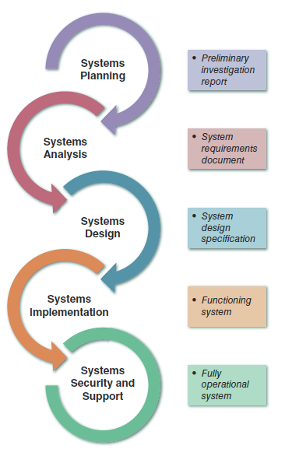
Systems Development Methods (Cont.)
The SDLC model usually includes five steps
Systems Planning
Systems Analysis
Systems Design
Systems Implementation
Systems Security and Support
FIGURE 1-25 Development phases and deliverables are
shown in the waterfall model. The circular symbols indicate
interaction among the phases.

Slide 34
Systems Development Methods (Cont.)
Systems Planning
Systems request – begins the process and describes problems or desired changes
Purpose of this phase is to perform a preliminary investigation – a critical step
Key part of preliminary investigation is a feasibility study

Slide 35
Systems Development Methods (Cont.)
Systems Analysis
Build a logical model of the new system
Perform fact-finding techniques
Build business models, data and process models, and object models
Deliverable is the system requirements document

Slide 36
Systems Development Methods (Cont.)
Systems Design
Create a physical model that satisfies all documented requirements
Design user interface
Identify outputs, inputs, and processes
Deliverable is the system design specification
Management and user involvement is critical

Slide 37
Systems Development Methods (Cont.)
Systems Implementation
New system is constructed
Programs are written and tested
System is installed
Deliverable is a completely functioning and documented information system
Systems Support and Security
A well-designed system must be secure, reliable, maintainable, and scalable
Most information systems need to be updated significantly or replaced after several years of operation

Slide 38
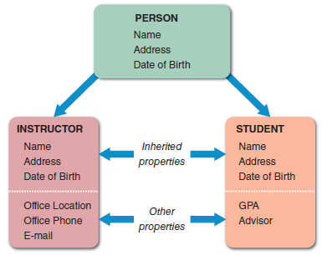
Systems Development Methods (Cont.)
Object-Oriented Analysis
Combines data and the processes that act on the data into things called objects
Objects are members of a class, which is a collection of similar objects
Built-in processes, called methods, can change an object’s properties
O-O methodology provides easy transition to O-O programming languages like Java
FIGURE 1-26 The PERSON class includes INSTRUCTOR and STUDENT objects, which have their own properties and inherited
properties.

Slide 39
Systems Development Methods (Cont.)
Agile Methods
Newest development technique as systems are developed incrementally
A series of prototypes are built and adjusted to meet user requirements
As the process continues, developers revise, extend, and merge earlier versions into the final product
Agile method emphasizes continuous feedback
Iterative development
Agile community has published the Agile Manifesto
Spiral model

Slide 40
Systems Development Methods (Cont.)
Agile Methods
Agile process determines the end result
Other adaptive variations and related methods exist
Two examples are Scrum and Extreme Programming (XP)
Analysts should understand the pros and cons of any approach before selecting a development method

Slide 41
Systems Development Methods (Cont.)
Other Development Methods
Teams consists of IT staff, users, and managers
joint application development (JAD)
Focuses on team-based fact-finding
Rapid application development (RAD)
A compressed version of the entire development process

Slide 42
Systems Development Methods (Cont.)
Develop a project plan
Involve users and listen carefully to them
Use project management tools to identify tasks and milestones
Develop accurate cost and benefit information
Remain flexible

Slide 43
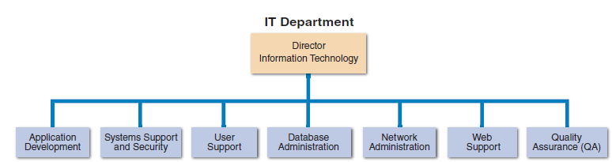
The Information Technology Department
FIGURE 1-29 Depending on its size, an IT department might have separate organizational units for these functions, or they might be combined into a smaller number of teams.

Slide 44
The Information Technology Department (Cont.)
Application Development
Systems are developed by teams consisting of users, managers, and IT staff members
Knowledge, Skills, and Education
Need technical knowledge, strong oral and written communication skills and analytic ability, an understanding of business operations, and critical thinking skills
Certification
Important credential

Slide 45
The Information Technology Department (Cont.)
Application Development
Systems are developed by teams consisting of users, managers, and IT staff members
Systems Support and Security
Provides vital protection and maintenance services
User Support
Provides users with technical information, training, and productivity support

Slide 46
The Information Technology Department (Cont.)
Database Administration
Involves data design, management, security, backup, and access systems
Network Administration
Includes hardware and software maintenance, support, and security
Web Support
Web support specialists design and construct Web pages, monitor traffic, manage hardware and software, and link Web-based applications to the company’s information systems
Quality Assurance
Team that reviews and tests all applications and systems changes to verify specifications and software quality standards

Slide 47
The Systems Analyst
Role
Analysts build a series of models, diagrams, and decision tables and uses other descriptive tools and techniques
An analyst’s most valuable skill is the ability to listen
An effective analyst will involve users in every step of the development process
Knowledge, Skills, and Education
Technical Knowledge
Communication Skills
Business Skills
Critical Thinking Skills
Education
Certification

Slide 48
The Systems Analyst (Cont.)
Career Opportunities
Companies will need systems analysts to apply new information technology, and the explosion in e-commerce will fuel IT job growth
What’s important?
Job Titles
Company Organization
Company Size
Salary, Location and Future Growth
Corporate Culture

Slide 49
Chapter Summary
IT refers to the combination of hardware and software resources that companies use to manage, access, communicate, and share information
The essential components of an information system are hardware, software, data, processes, and people
Successful companies offer a mix of products, technical and financial services, consulting, and customer support

Slide 50
Chapter Summary (Cont.)
Information systems are identified as enterprise computing systems, transaction processing systems, business support systems, knowledge management systems, or user productivity systems
Organization structure includes top managers, middle managers and knowledge workers, supervisors and team leaders

Slide 51
Chapter Summary (Cont.)
The IT department develops, maintains, and operates a company’s information systems
Systems analysts need a combination of technical and business knowledge, analytical ability, and communication skills
Systems analysts need to consider salary, location, and future growth potential when making a career decision

